Slide 1



WFS2 - GRP1
BUG TRACKING
SYSTEM
Presented by: BUrGlars

Slide 2
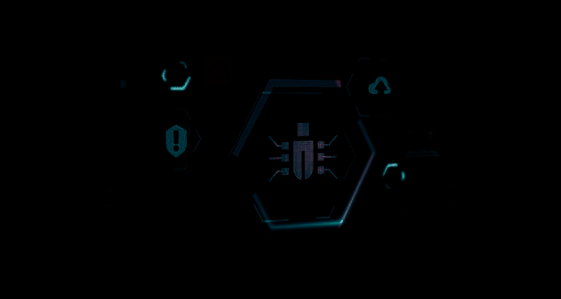








1 - Introduction
5 - Workflow & Process
CONTENTS
2 - Project Overview
6 - Testing & Quality Assurance
3 - Diagrams & UI Interface
7 - Future Enhancements
4 - Technology Stack
8 - Conclusion

Slide 3
OUR TEAM
RUTVIK MANCHEKAR
VRUSHALI DATIR
VEDANT DAMBRE
HARSHAL SONAWANE
KARTHIK KALLUR
TEJASWINI KHANDEKAR
MONIKA BUGALIA

Slide 4
INTRODUCTION
Purpose: Essential tool for managing and resolving bugs efficiently in software development.
Problem Statement: Difficulty in tracking and managing bugs without a systematic approach.
Objective: Streamline bug tracking, improve resolution time, and enhance team collaboration.

Slide 5





PROJECT OVERVIEW
SCOPE
TARGET AUDIENCE
GOALS
Covers bug reporting, assignment, tracking, status management, and reporting.
Developers, testers, and project managers
Enhance bug resolution efficiency by 30%.

Slide 6
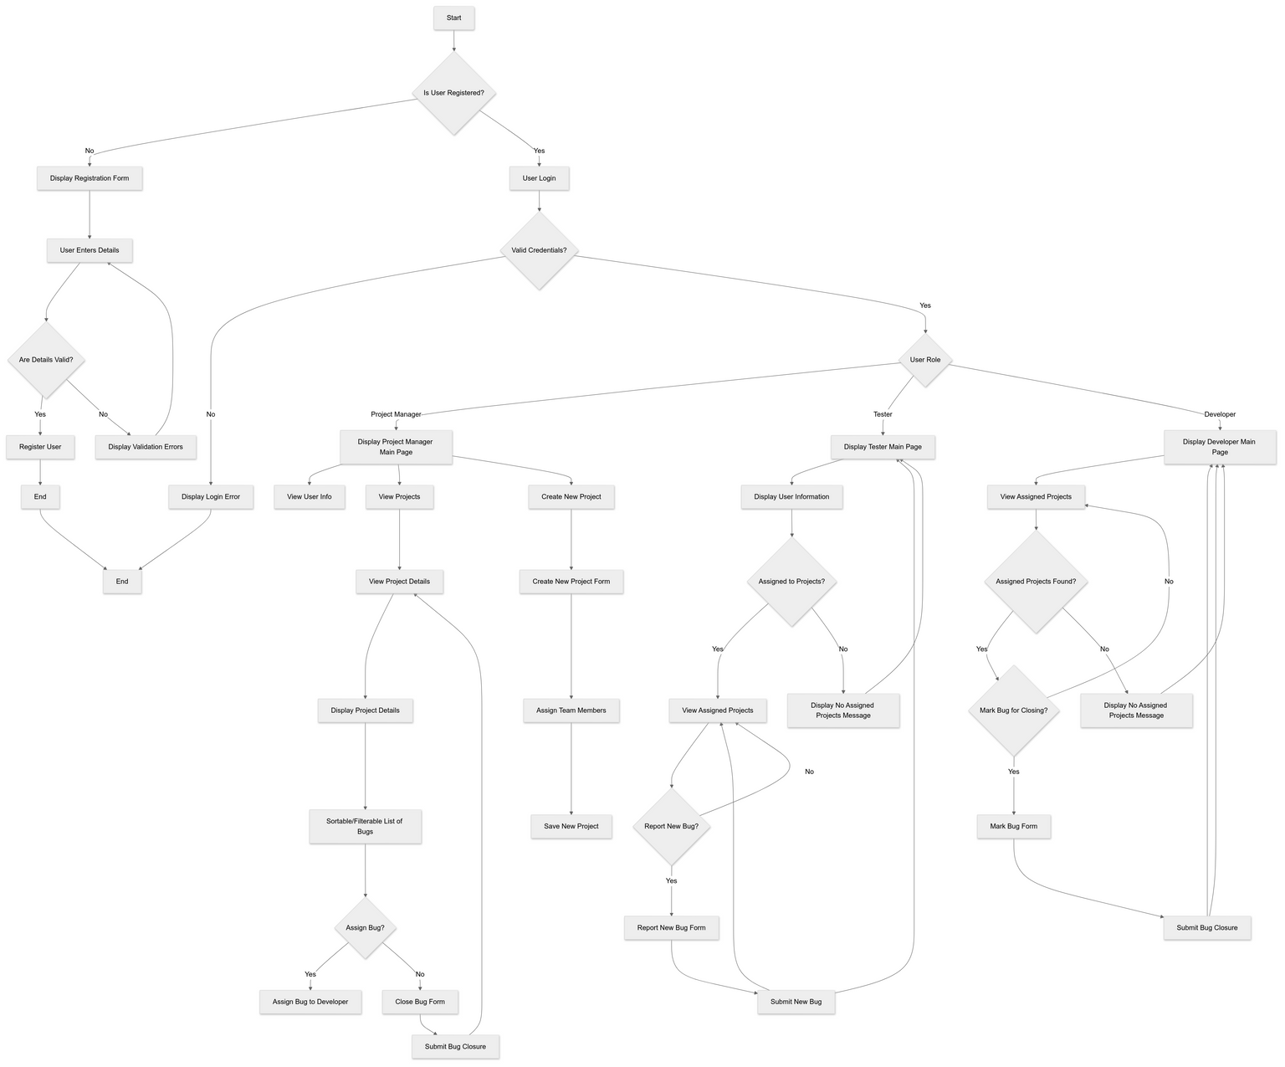
FLOWCHART

Slide 7
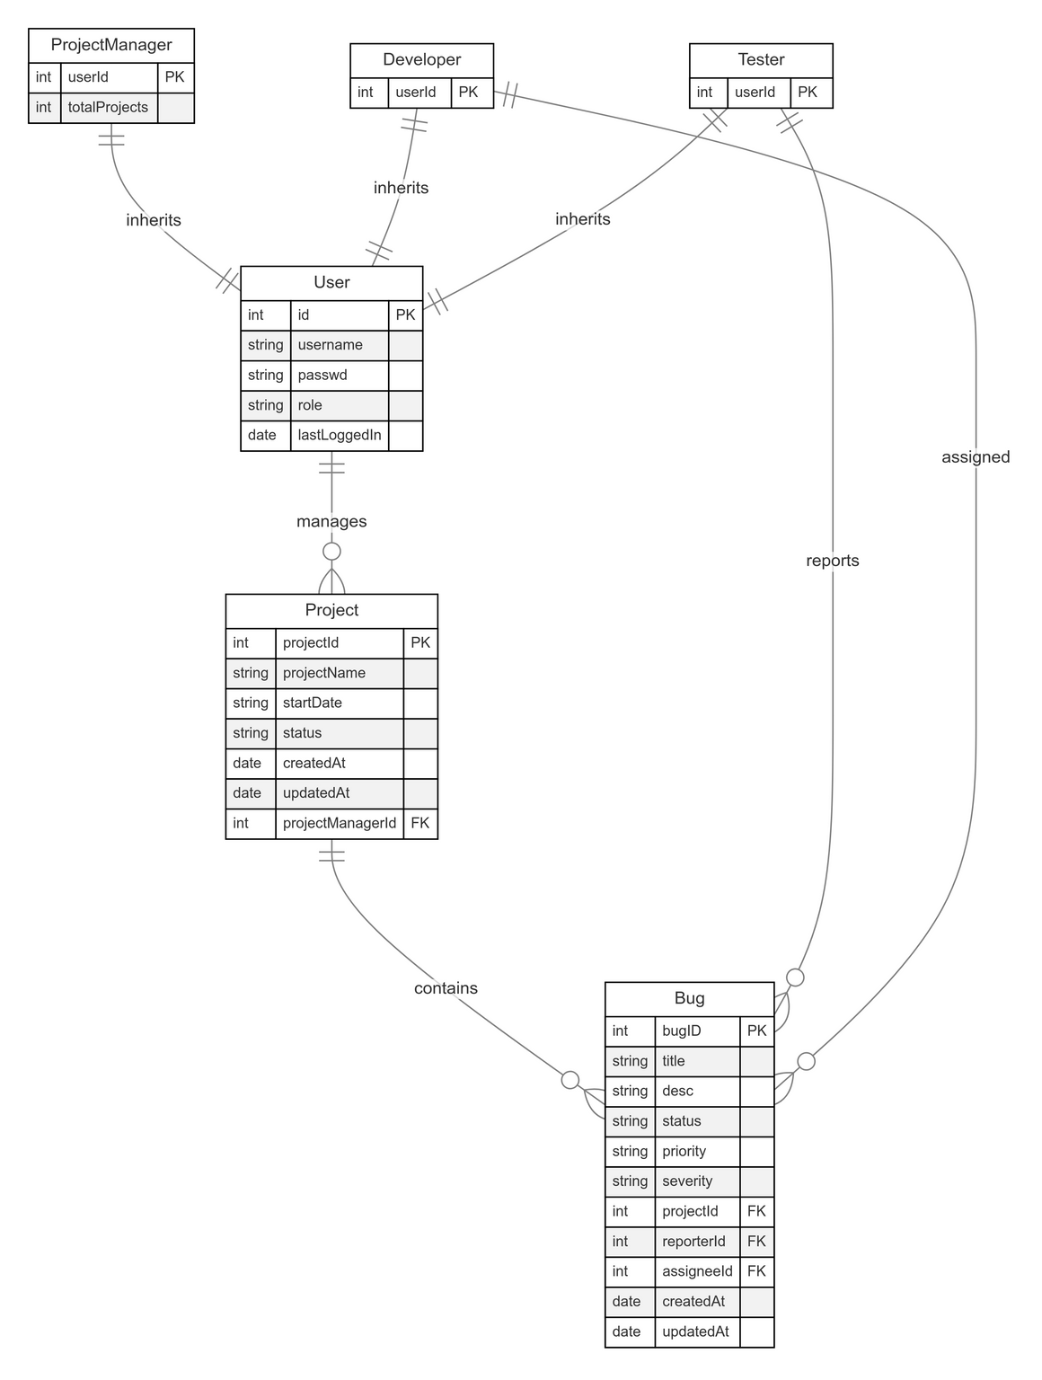
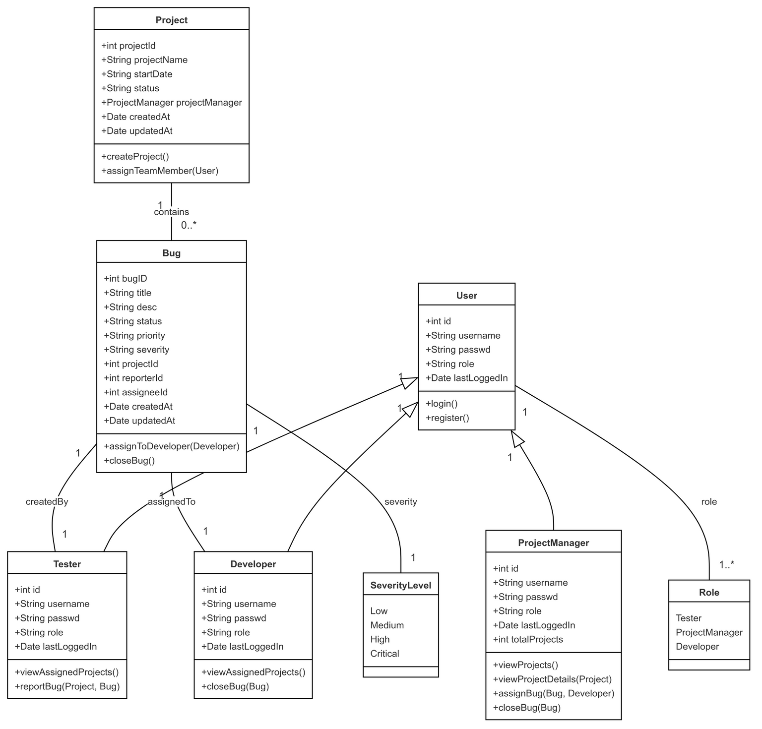
ER DIAGRAM
CLASS DIAGRAM

Slide 8
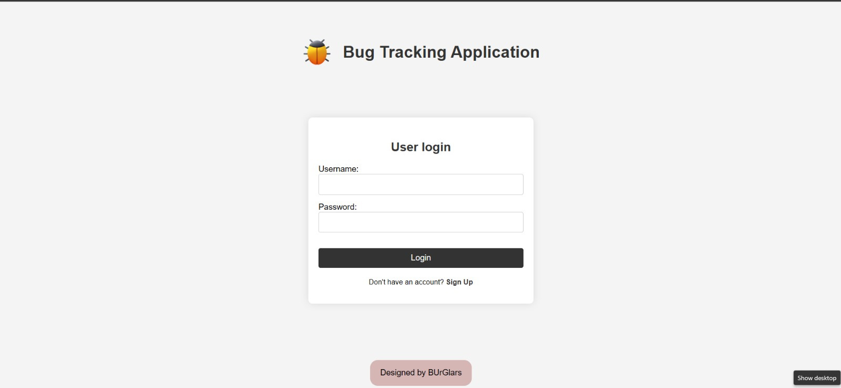
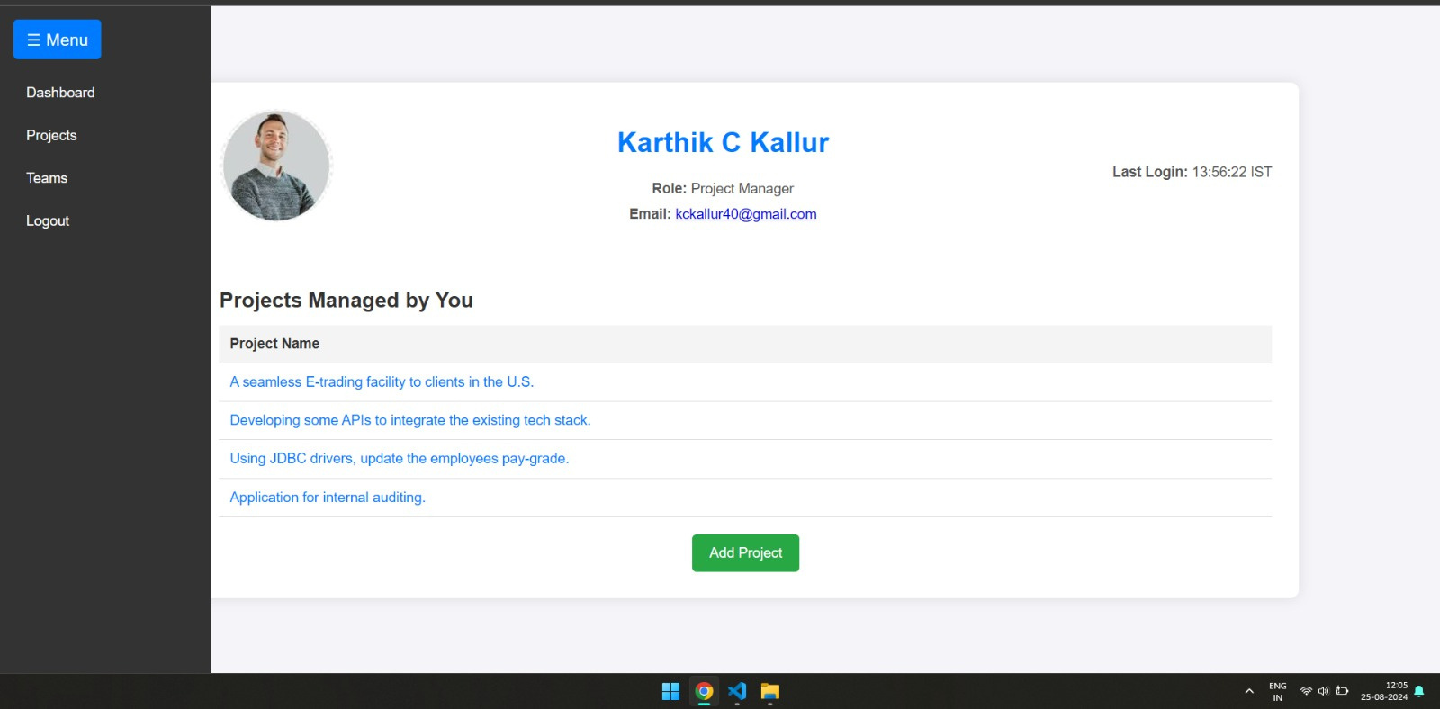
UI INTERFACE

Slide 9
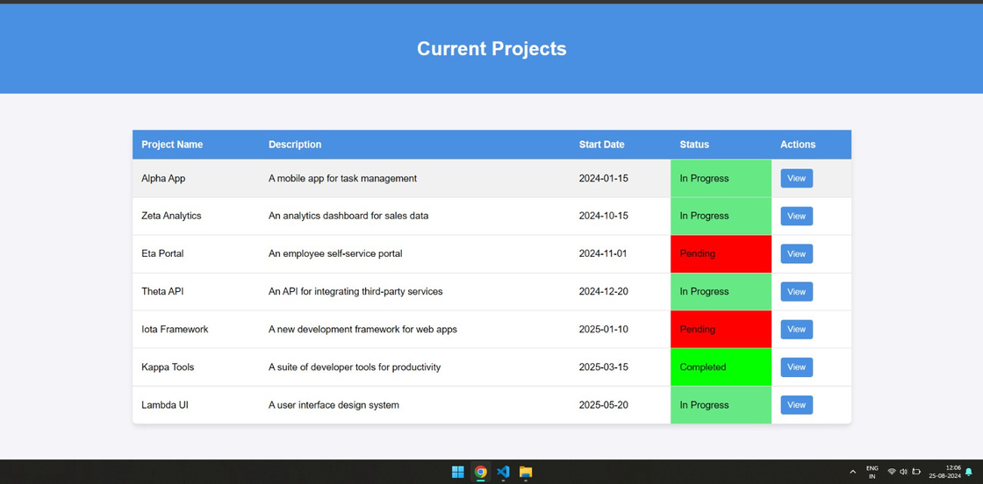
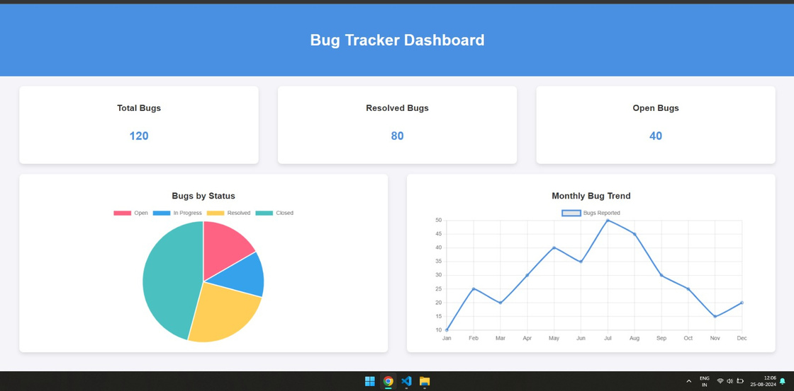
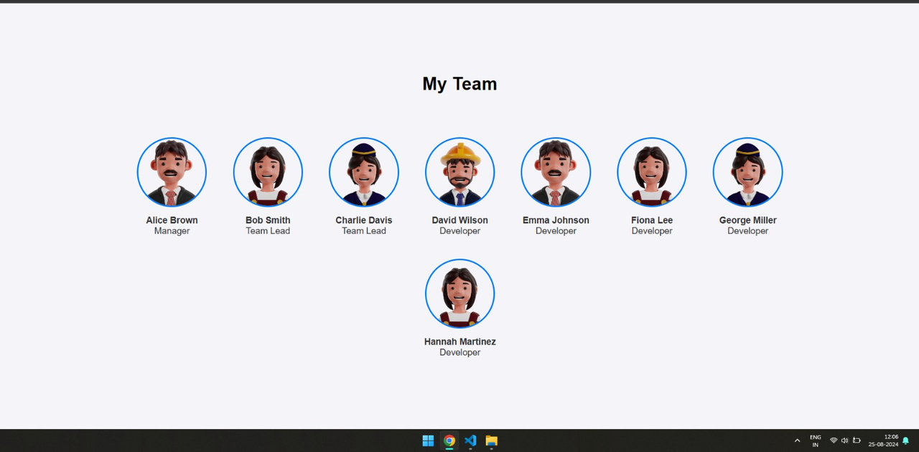
UI INTERFACE

Slide 10
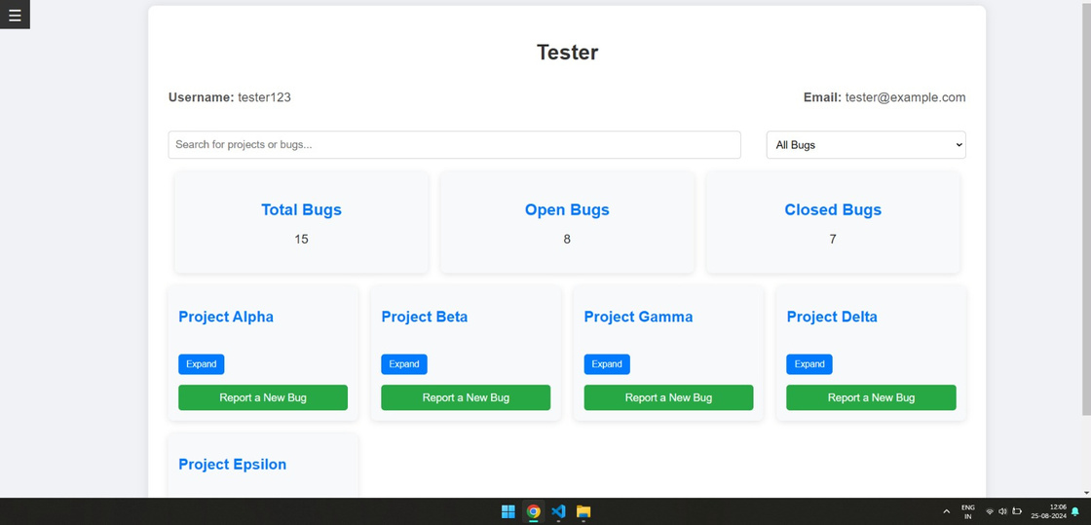
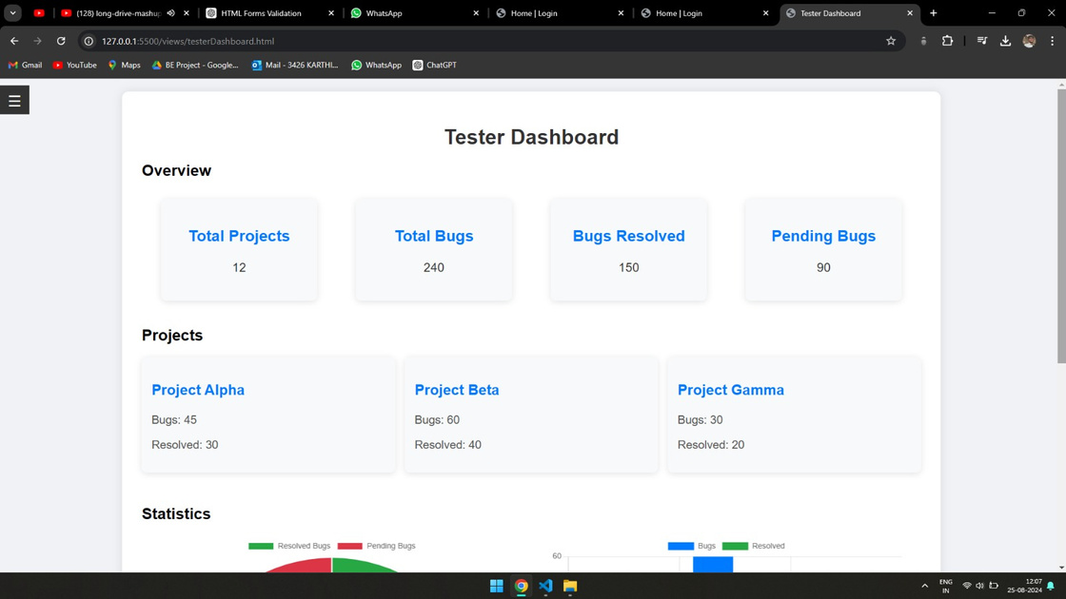
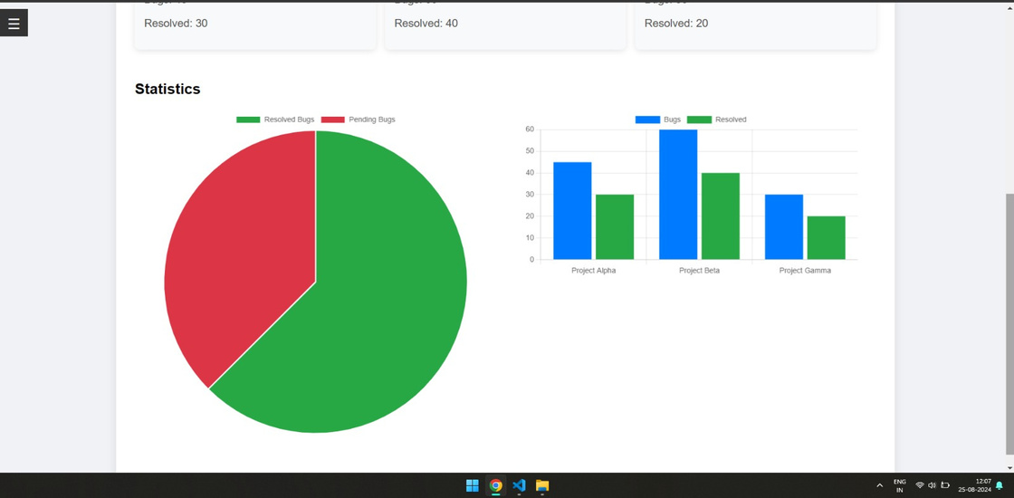
UI INTERFACE

Slide 11
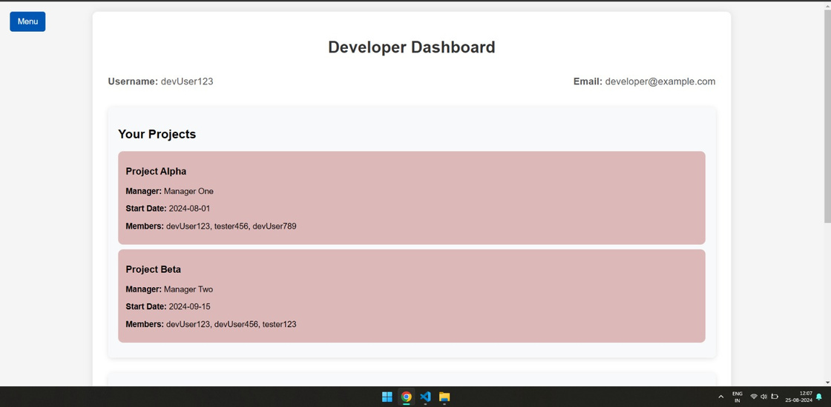
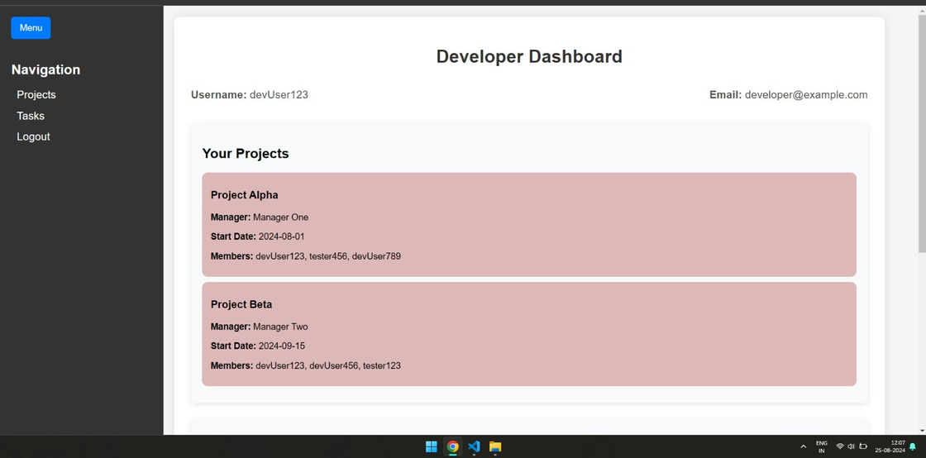
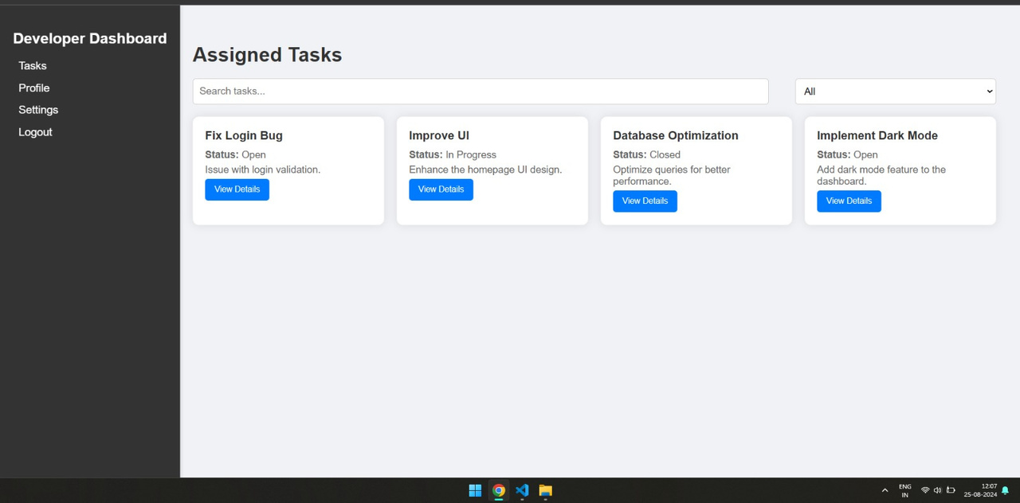
UI INTERFACE

Slide 12


TECHNOLOGY STACK
Frontend:
HTML
CSS
JavaScript
Bootstrap
Backend:
Java
JDBC
Database:
MySQL
Cloud
Tools:
JUnit for
testing

Slide 13

WORKFLOW & PROCESS
Bug Lifecycle: From creation to resolution and closure
Process Flow: Clear process from bug detection to resolution.
March
Collaboration: Smooth collaboration between different roles.
Collaboration: Smooth collaboration between different roles.
Security &
Data Protection
May
Data Encryption: Protect data at rest and in transit.
Audit Trails: Comprehensive tracking of all changes for accountability.

Slide 14

TESTING & QUALITY ASSURANCE
Strategy: Unit testing, integration testing, and user
acceptance testing.
Test Cases: Representative examples of key test scenarios.
Metrics: Measure efficiency with metrics like mean time
to resolution.

Slide 15
FUTURE ENHANCEMENTS
Planned Features: AI-powered bug classification, CI/CD integration.
Scalability: : Designed to handle growing user bases.
Feedback Loop::Continuous improvement based on user feedback.

Slide 16
CONCLUSION
Summary: Recap of the Bug Tracking System’s key benefits and features.
Value Proposition: Ensures efficient bug resolution and improves team collaboration.
Call to Action: Next steps for implementation or pilot testing.

Slide 17

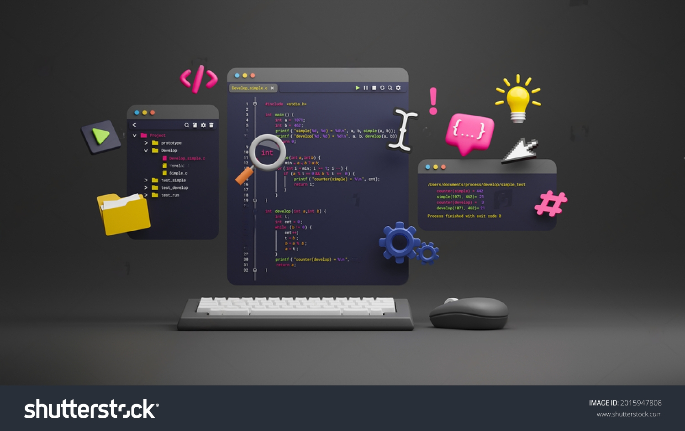


WFS2 - GRP1
THANK YOU
BUrGlars

